Slide 1

Sticky Notes Web Application
Minor Project
Lakshmi Narain College of Technology Excellence, Bhopal(MP)
Guided by :-
Prof. Vandita Pandey Department of Computer Science and Engineering
Submitted by :-
Sakshi Kaushal(0176CS211149)

Slide 2
INTRODUCTION
The Sticky Notes Web Application emerges as a versatile and innovative tool for modern note-taking and collaboration.
The Sticky Notes Web Application goes beyond mere replication, introducing powerful features that leverage the capabilities of the digital medium.
This application motivates users to embrace a more efficient, organized, and interconnected approach to capturing and sharing ideas.
The familiar simplicity of physical sticky notes is preserved, making the transition to a digital environment a smooth and natural process for users of all backgrounds.

Slide 3
FEATURES
Sticky Notes Web Applications offer a range of features to enhance user productivity and organization.
Common features include:
1) Note Creation and Editing: Users can easily create, edit, and delete digital sticky notes.
2) Color Coding and Organization: Sticky notes often support color coding to help users
categorize and organize their notes efficiently.
3) Synchronization: Many applications offer synchronization across devices, ensuring users can
access their notes from different platforms.

Slide 4
PROBLEM SOLVED
Sticky notes serve as visual reminders for tasks and events.
Categorize and group notes to bring order to your information.
Web applications provide synchronization, allowing access from anywhere.
Sticky notes offer a simple task management system.
Sticky notes provide flexibility in task organization and layout.

Slide 5
LANGUAGE USED
HTML:HTML stands for Hyper-Text Markup Language. It is the standard markup language
used to create and design documents on the World Wide Web. HTML describes the
structure of a web page semantically and is primarily composed of a series of elements.
CSS:CSS stands for Cascading Style Sheets. CSS describes how HTML elements are to be displayed
on screen, paper, or in other media. It can control the layout of multiple web pages all at once.
JavaScript: JavaScript is the world's most popular programming language. JavaScript is the
programming language of the Web. JavaScript is easy to learn. JavaScript accepts both
double and single quotes

Slide 6
MODULES USED
React, Angular, or Vue.js: These are popular JavaScript frameworks/libraries for building user interfaces. They allow for the creation of dynamic and interactive user interfaces.
CSS Frameworks (e.g., Bootstrap, Tailwind CSS): These frameworks can provide pre-designed UI components and help with responsive design.
MongoDB, PostgreSQL, MySQL: Depending on the requirements, you might use a relational or NoSQL database to store information related to the sticky notes.

Slide 7
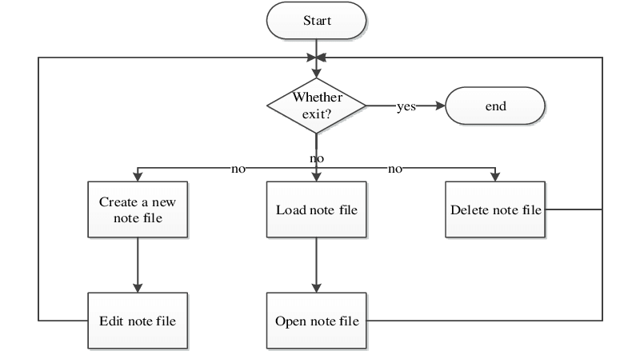
FLOW CHART

Slide 8
MINIMUM HARDWARE REQUIRMENTS
Processor (CPU):
Dual-core processor or equivalent.
Intel® Core™ i3 CPU
Memory (RAM):
4 GB RAM
Storage:
At least 20 GB of available disk space.

Slide 9
MINIMUM SOFTWARE REQUIRMENTS
Operating System:
Windows 7 (32-bit)
Web Browser:
Google Chrome
Microsoft Edge
Database:
If your Sticky Notes application uses a database, you might choose a
lightweight database like SQLite or use a cloud-based database service.
Programming Languages:
HTML, CSS, JavaScript for the frontend.

Slide 10
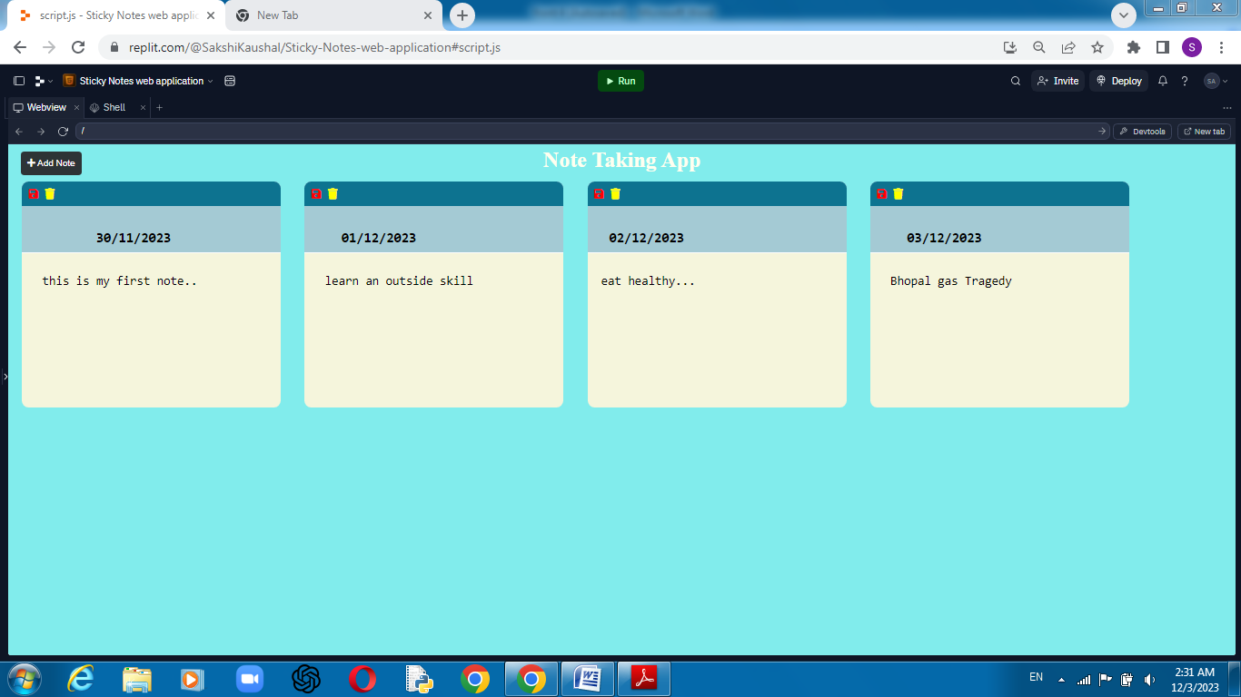
USER INTERFACE

Slide 11
CONCLUSION
The development of a Sticky Notes web application provides a convenient and intuitive platform for users to manage and organize their notes digitally.
The application offers features such as note creation, updating, and deletion, providing a user-friendly interface that mimics the experience of physical sticky notes.
The implementation involves frontend and backend technologies, user authentication, data storage, and various testing phases to ensure functionality, security, and usability.

Slide 12
**THANK YOU**

